Slide 1
Augmediated reality system based on 3D camera selfgesture sensing
Authors
Raymond Lo, Alexander Chen, Valmiki Rampersad, Jason Huang, Han Wu, Steve Mann
Presenters
Alexander Chen
Valmiki Rampersad

Slide 2
Table of Contents
Implementation
Segmentation Aid for Object Recognition
Demo
Privacy & Social

Slide 3
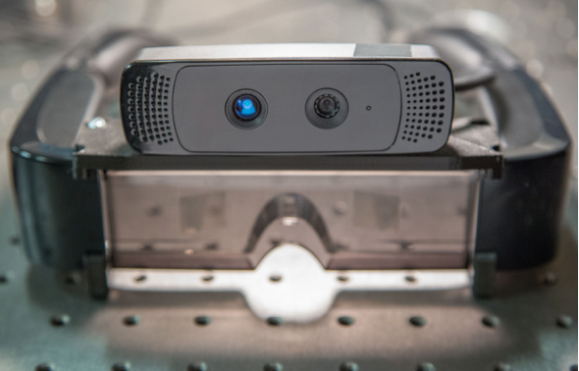
Implementation(Hardware)
Hardware:
Camera: PrimeSense based 3D camera (Kinect or Asus Xtion Pro)
Display: Epson Moverio BT-100
Processor: ODROID-X2

Slide 4
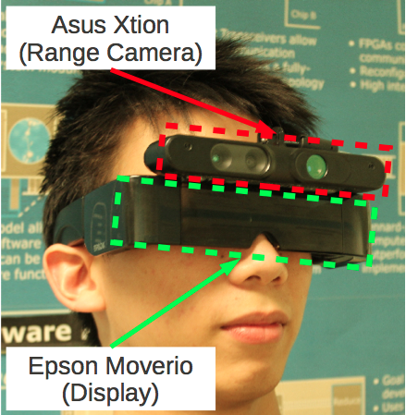
Implementation(Hardware)

Slide 5
Implementation(Algorithm)
Algorithms:
Segmentation:
using depth and IR images
Classification:
using neural network

Slide 6



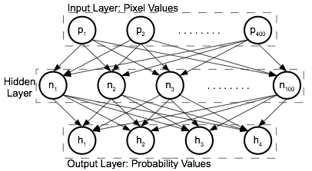
Implementation(Our Pipeline)
Extract Frame
Crop Frame
Resize
Recognize

Slide 7
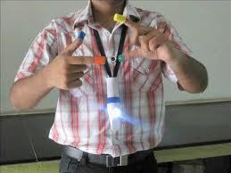
Implementation (Segmentation)
Background: Marker Based Segmentation

Slide 8
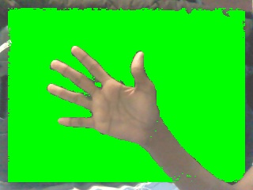
Implementation (Segmentation)
Background: Skin Tone Based Segmentation

Slide 9
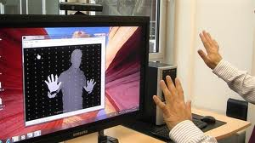
Implementation (Segmentation)
Background: Third Person Based Gesture

Slide 10

Implementation(Segmentation)

Slide 11

Implementation(Segmentation)

Slide 12
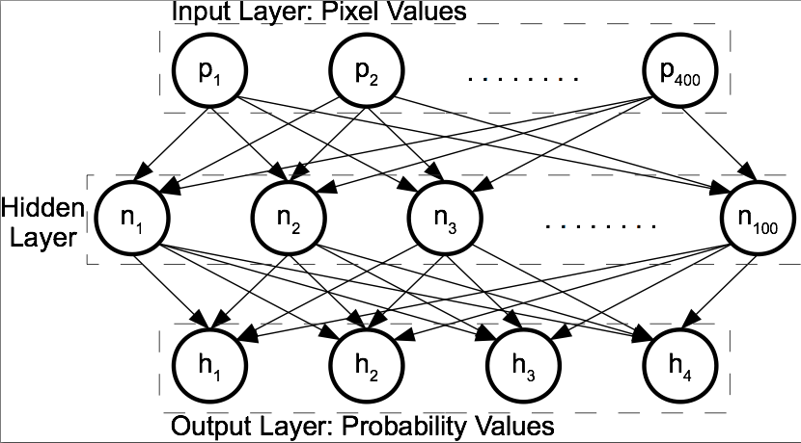
Implementation(Classification)
Classification Algorithm: Single Layer Neural Network

Slide 13


Implementation(Classification)

Slide 14
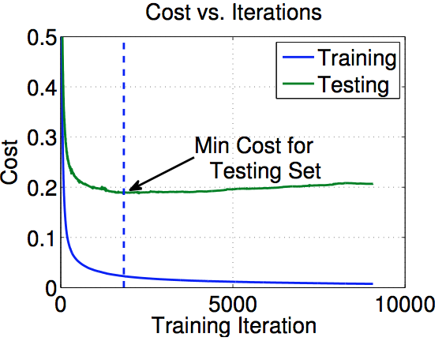
Implementation(Classification)

Slide 15
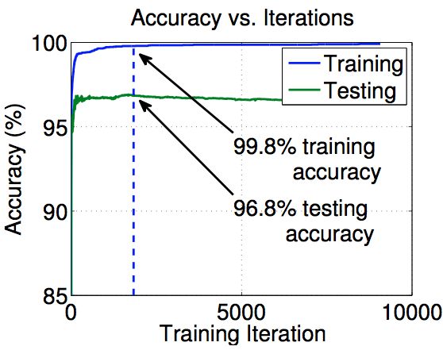
Implementation(Classification)

Slide 16
Table of Contents
Implementation
Segmentation Aid for Object Recognition
Demo
Privacy & Social

Slide 17

Segmentation Aid For Object Recognition
Background: Image with lots of objects

Slide 18
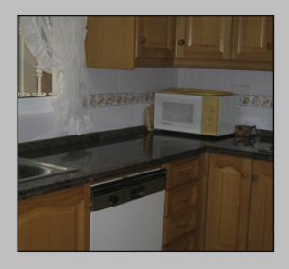
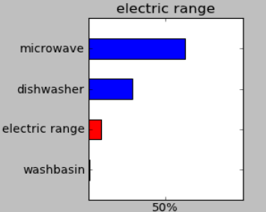
Segmentation Aid For Object Recognition
Background: Neural Net on Multi-Object Image

Slide 19
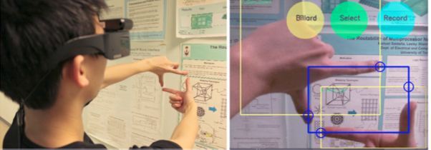
Segmentation Aid For Object Recognition
Our Approach:

Slide 20
Table of Contents
Implementation
Segmentation Aid for Object Recognition
Demo
Privacy & Social

Slide 21
Demo
Demo

Slide 22
Table of Contents
Implementation
Segmentation Aid for Object Recognition
Demo
Privacy & Social

Slide 23

Privacy & Social

Slide 24
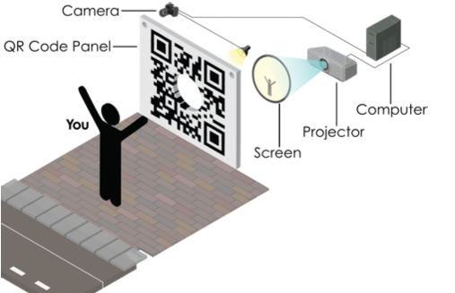
Privacy & Social

Slide 25
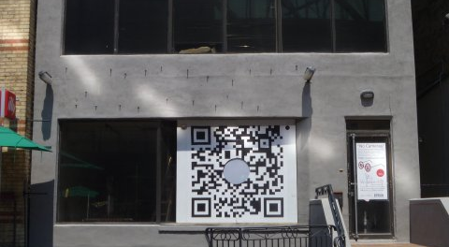
Privacy & Social

Slide 26
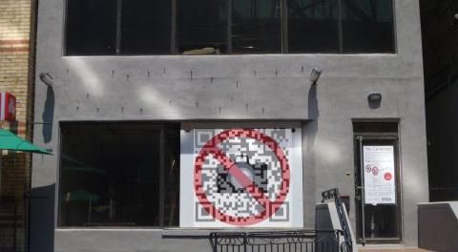
Privacy & Social

Slide 27
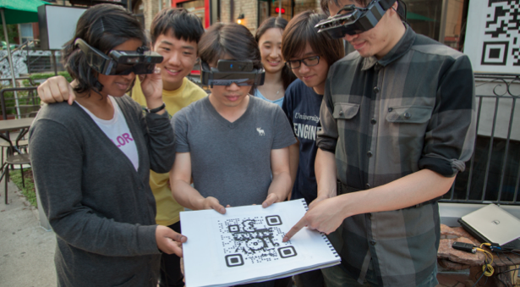
Privacy & Social

Slide 28
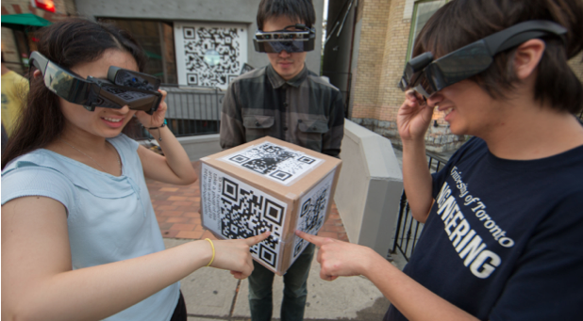
Privacy & Social

Slide 29
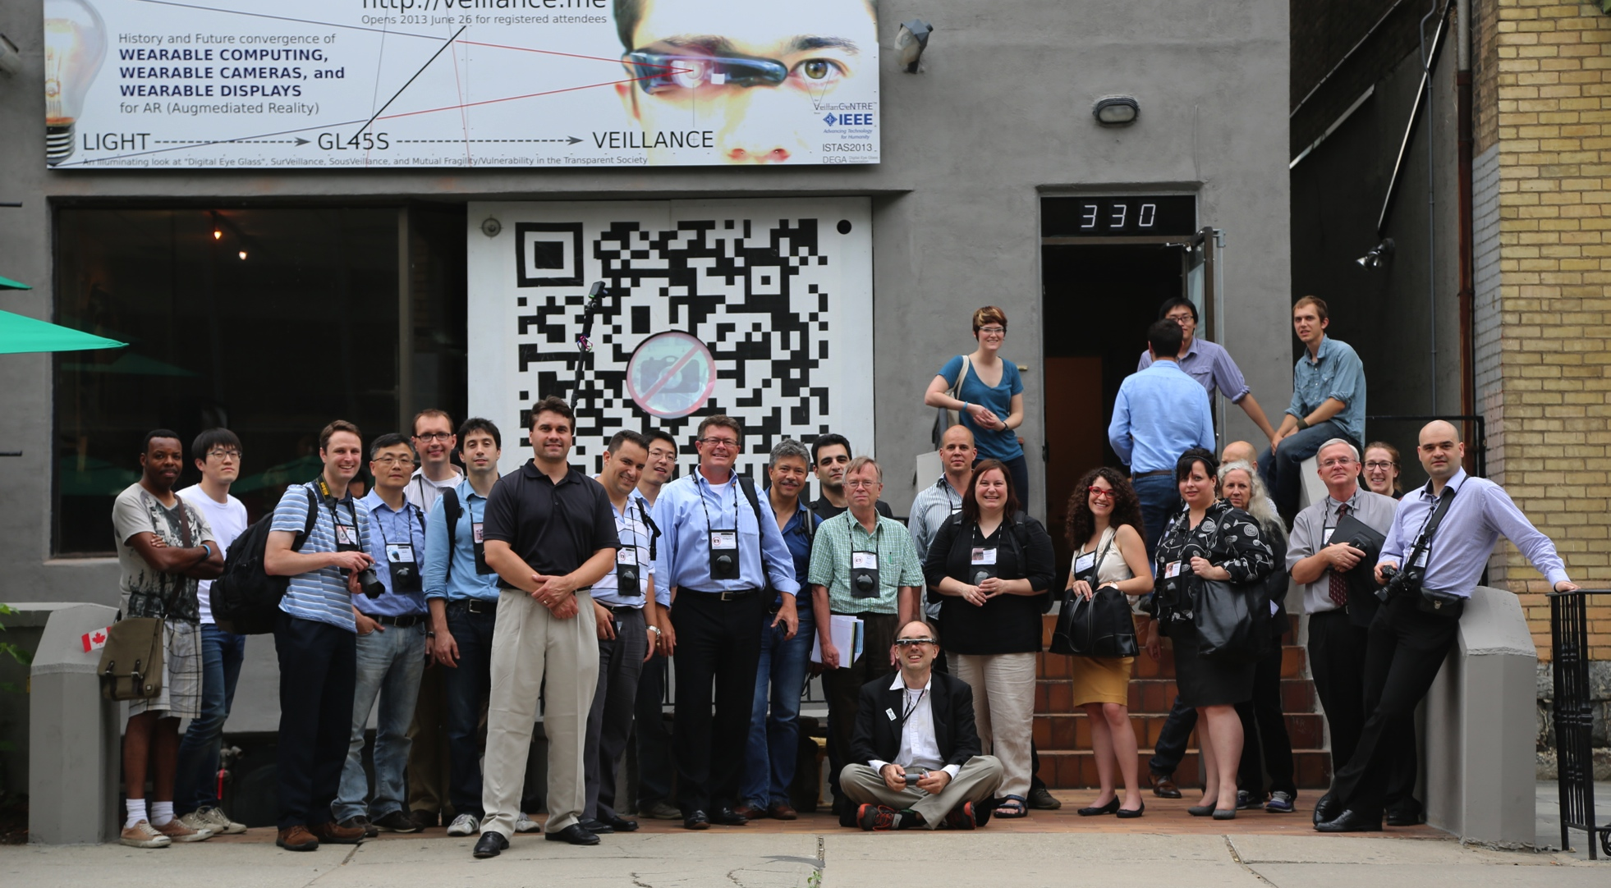
Thank You!

